Slide 1

Common Birds of
Wake County
Birds Commonly Seen Around
Your Neighborhood

Slide 2
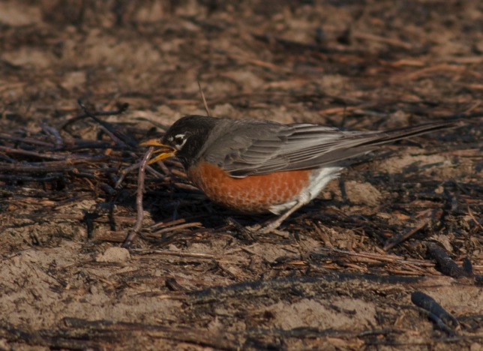
American Robin
                Dark gray back and a brick red breast
                Song is a clear caroling of short phrases often very long in duration. Calls are a tyeep and tut-tut-tut.
                Very common bird found across the US often seen standing upright on lawns

Slide 3
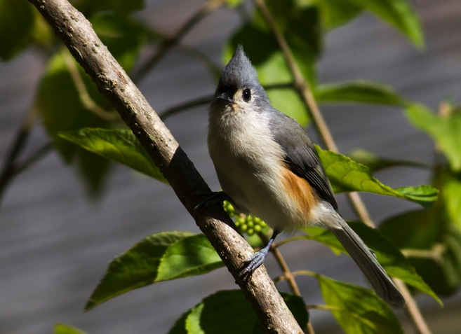
Tufted Titmouse
                Small gray mouse colored bird with a tufted crest.
                Readily uses seed feeders
                Song is a clear, whistled cadence that sounds like Peter, Peter, Peter

Slide 4
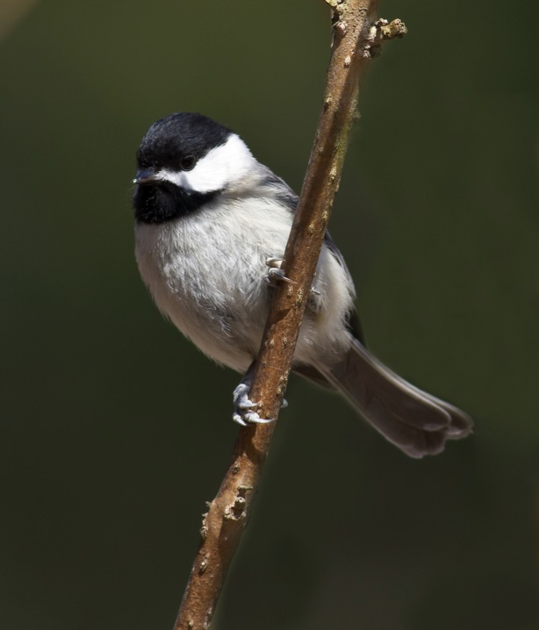
Carolina Chickadee
                Black cap with a white cheek patch and black throat
                Song says four syllable fee-bee, fee-bay
                Often found in mixed flocks with tufted titmouse

Slide 5
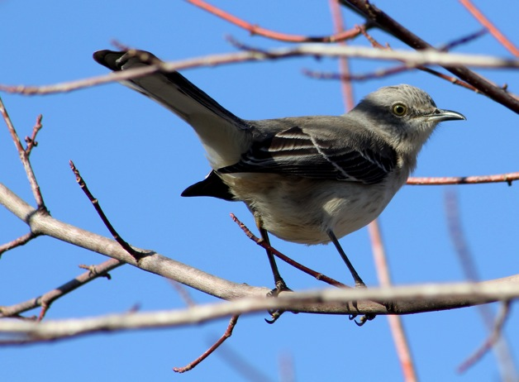
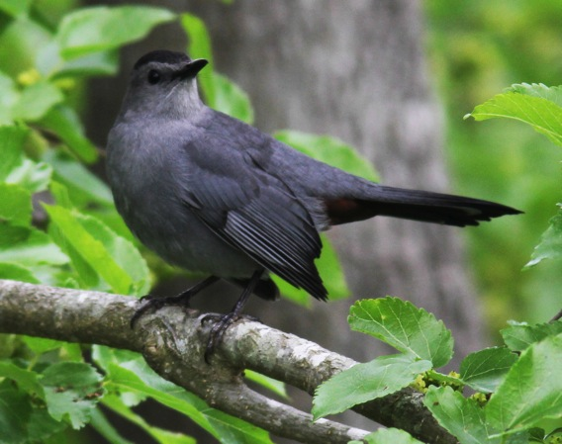
No. Mockingbird/Gray Catbird
                Mockingbird is a slim gray bird with white wing bars
                Catbird is a slate gray bird with a black cap and chestnut vent
                Both birds can imitate other bird songs and a variety of sounds
                Catbird can mew like a cat while the mockingbird makes a tchack call

Slide 6
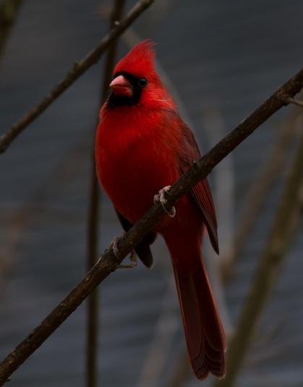
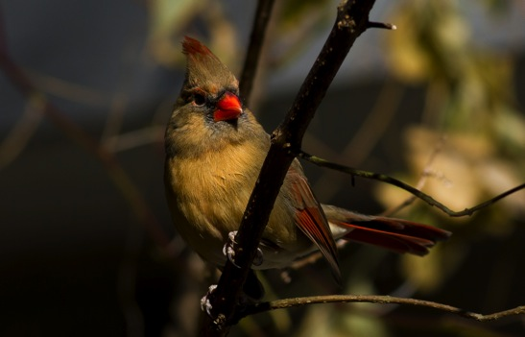
Northern Cardinal
                An all red bird with a large crest and a black patch around a large reddish bill
                Female is similar to male except it is buff brown with some red on the wings and tail
                Song is a series of clear loud notes sounding like what-cheer, what-cheer or birdy-birdy-birdy

Slide 7
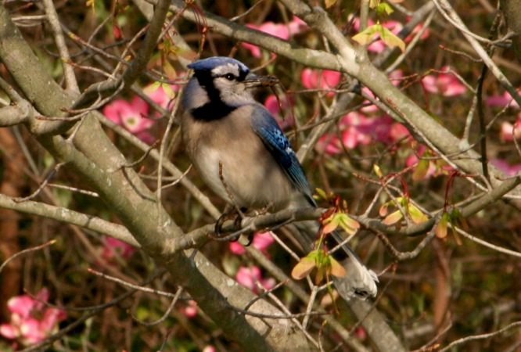
Blue Jay
                Crested jay with bold white spots on the blue wings and tail and a black necklace
                Call is loud jay or jeeah and a musical queedle, queedle
                Moves in social groups, alerts to your presence

Slide 8
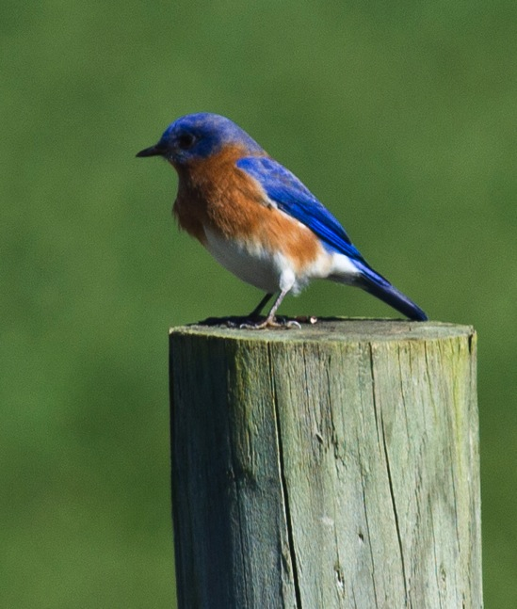
Eastern Bluebird
                A blue bird with rusty orange breast
                Song is 3 or 4 gurgling notes, Call is a musical chur-wi
                Nests readily in nest boxes placed out to replace tree cavities lost due to increased competition.

Slide 9
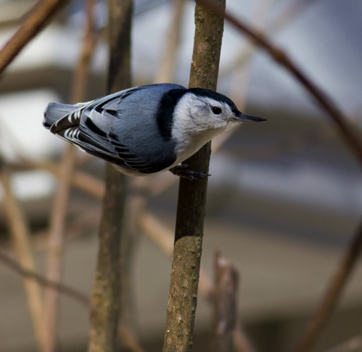
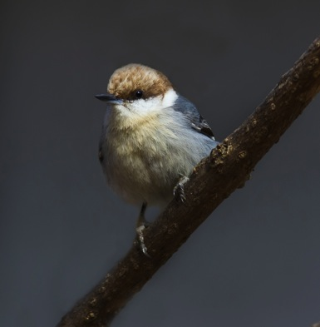
Brown-Headed and White-Breasted Nuthatches
                White-breasted has a black cap with black eye on a white face.
                Brown-headed is smaller and has a brown cap.
                Brown-Headed sounds like a “squeaky toy”. The White-breasted has a nasal song on one pitch like whi whi whi whi.
                Birds feed on insects found hiding on the bark of trees.

Slide 10
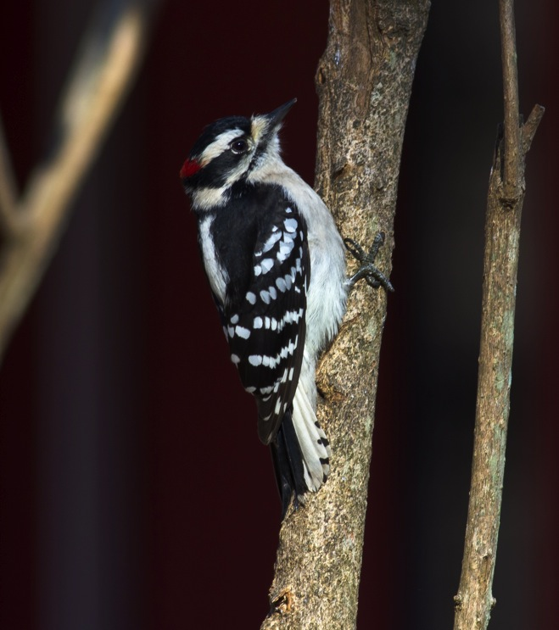
Downy Woodpecker
                A small black and white woodpecker with a small sharp bill.
                Makes a pick call and a series of whinny notes
                Climbs trees to drill for insects by using its stiff tail feathers and gripping feet.

Slide 11
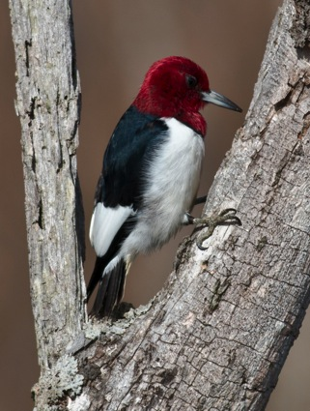
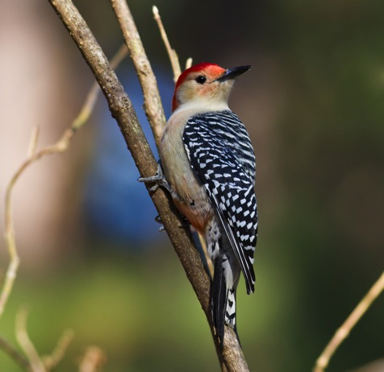
Red-Bellied and Red-Headed Woodpeckers
                Red-heads are a black/white woodpecker with an entirely red head. Red-bellies have a red toupee and black/white ladder pattern back.
                Red-heads say a loud queer, queeah. Red-bellies call out kwirr or churr.
                Woodpeckers can absorb the pounding with built in shock absorbers.

Slide 12
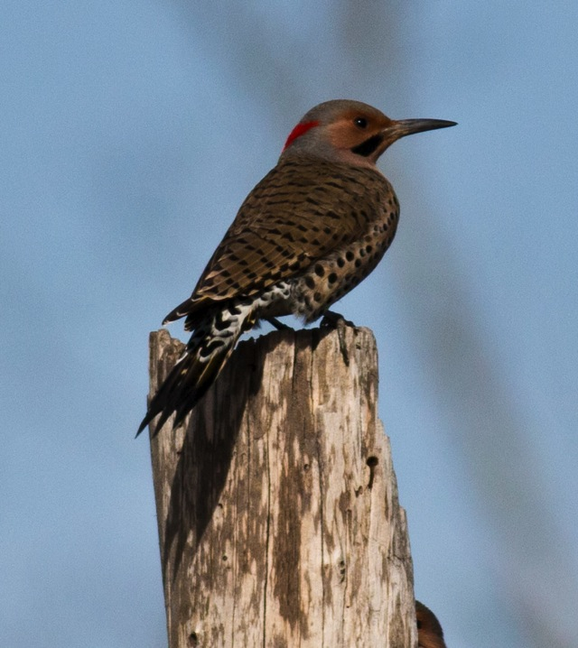
Northern Flicker
                Large brown backed woodpecker with a white rump patch.
                Calls loudly wick, wick, wick, or a loud klee-yer
                Will feed on ants on the ground
                Eastern birds have yellow feather shafts on the wings while western birds are red shafted.

Slide 13
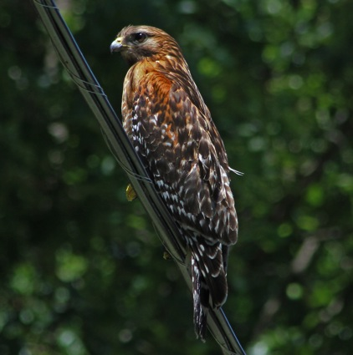
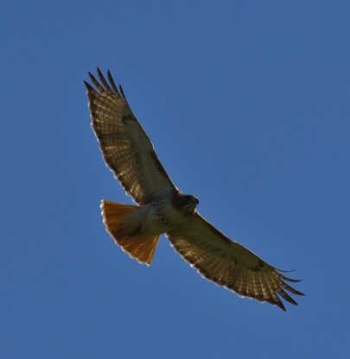
Red-Tailed and Red-Shouldered Hawks
                Red-shoulders are a medium sized hawk with black and white bands on the tail, red shoulders and breast. Red-tails are a larger hawk with a white front with a streaked belly band and orange-ish-red tail.
                Red-shoulders call is two syllable kee-yer! Red-Tails is a thin squeal, keeer-r-r .
                Red-shoulders often nest in forested communities. Red-tails nest in more open county in large trees.

Slide 14
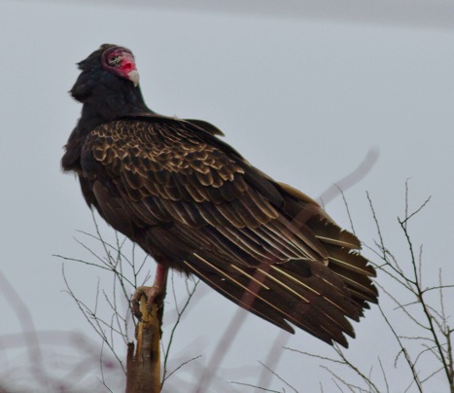
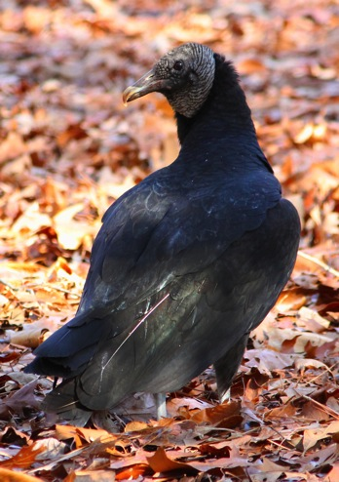
Turkey and Black Vultures
                Turkey Vultures are large birds with a two tone wings seen soaring in a shallow V wings. Black Vultures are smaller with white palm patches on the wing.
                Away from the nest, vultures are generally silent with an occasional hiss.
                Eat dead or dying animals

Slide 15
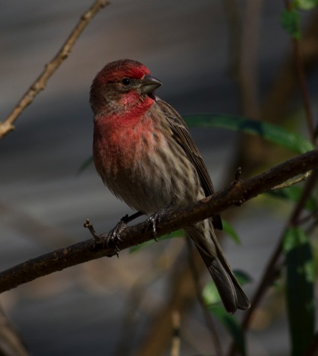
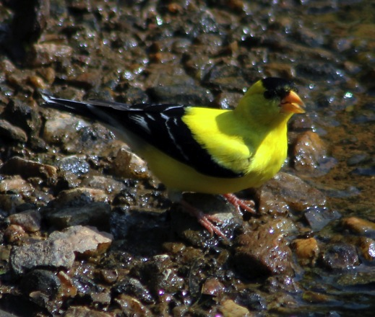
House Finch and Goldfinch
                House Finches are reddish with dark streaks on the sides. Goldfinch are bright yellow with a black cap and wing.
                House Finches have a song that often end with a wheer. Goldfinches seem to say po-ta-to-chip when flying.
                House Finches have been introduced from SW US. Goldfinches molt into a dull brown olive color in the winter.

Slide 16
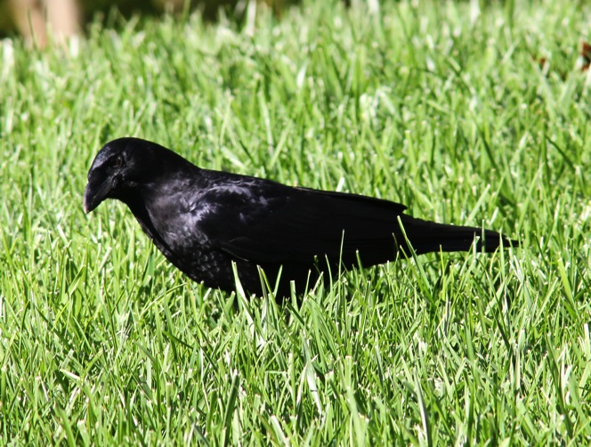
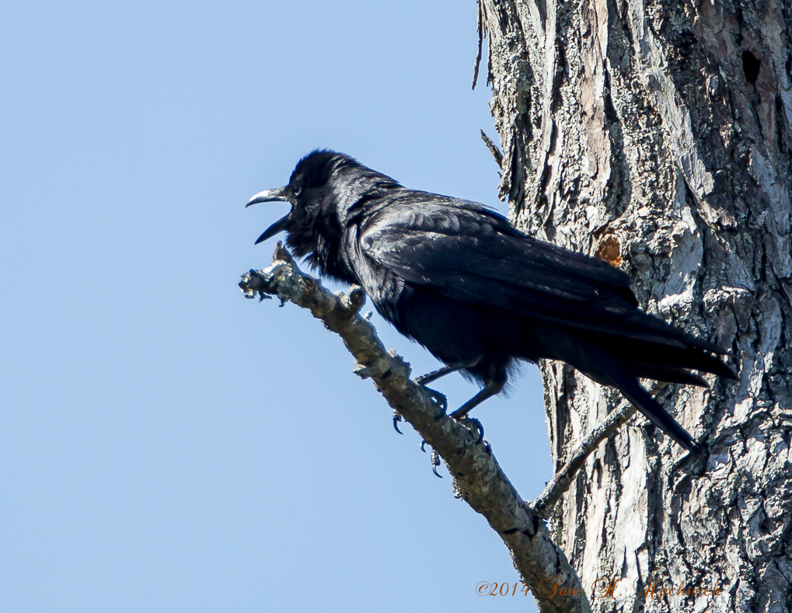
American & Fish Crow
                American Crows are large, chunky, dark birds. Fish Crows are almost identical but are smaller and slimmer.
                American Crows call the familiar caw, caw, caw while the Fish Crow is more nasal car or ca or ca-ha.
                Crows are social birds and are very intelligent.

Slide 17
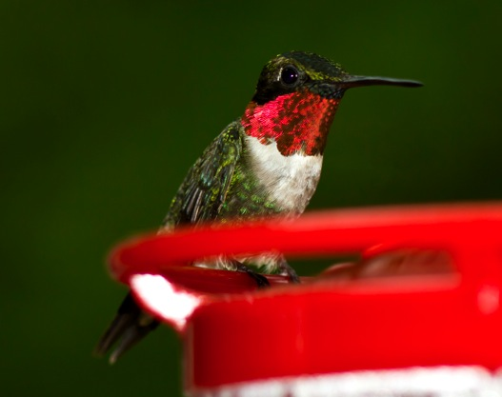
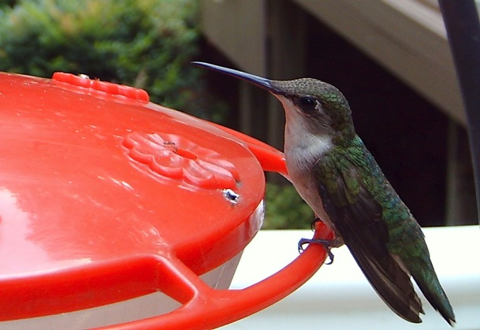
Ruby Throated Hummingbird
                Male has a fiery red throat with an iridescent green back with a forked tail. Females lack the red throat and forked tail.
                Chase calls are high and squeaky.
                Hummingbirds are attracted to some flowers for nectar and will feed at sugar water feeders.

Slide 18
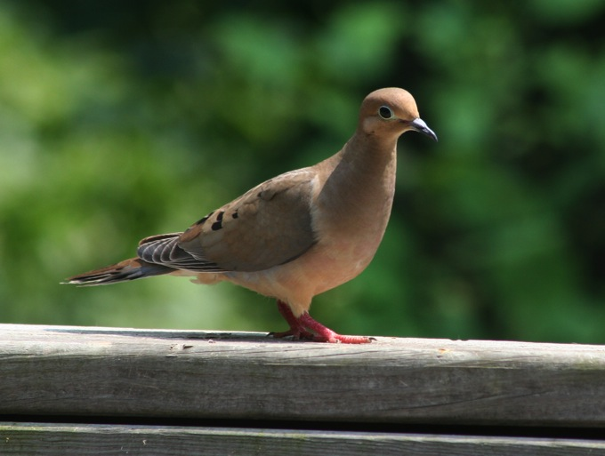
Mourning Dove
                A slender dove with a brown and gray body with a long pointed tail with white on the outer tail feathers.
                Doves sing a mournful series of coah, coo, coo, coo.
                Mourning Doves build a crude stick nest to raise their young. Sometimes they will nest several times in a season.

Slide 19
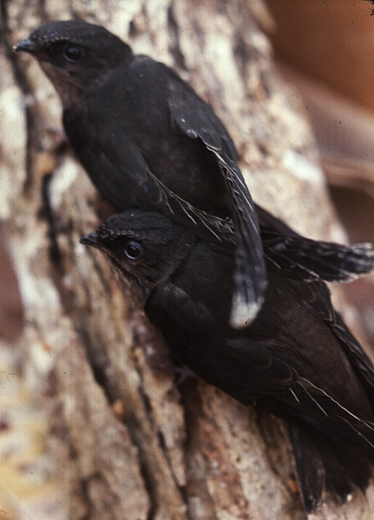
Chimney Swift
                A blackish swallow like bird. Often described as a flying cigar.
                Chimney Swifts emit a very rapid chittering call in flight.
                Chimney Swifts have adapted to roosting and nesting in open chimneys instead of large hollow trees.

Slide 20
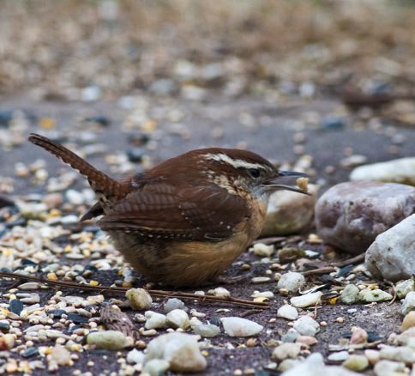
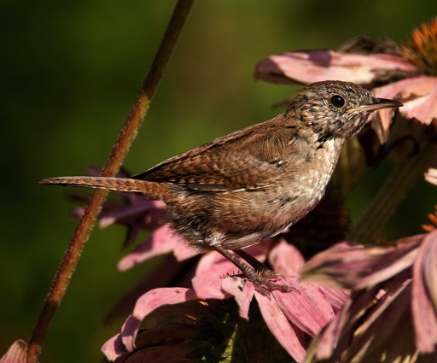
Carolina Wren and House Wren
                Carolina Wrens are a large brown wren with a white eyebrow stripe. House Wrens are a smaller gray-brown wren.
                Carolinas sing tea-kettle, tea-kettle, tea-kettle. House Wrens sing a long rapid gurgle of notes.
                Both birds prefer to nest in tight cavities.

Slide 21
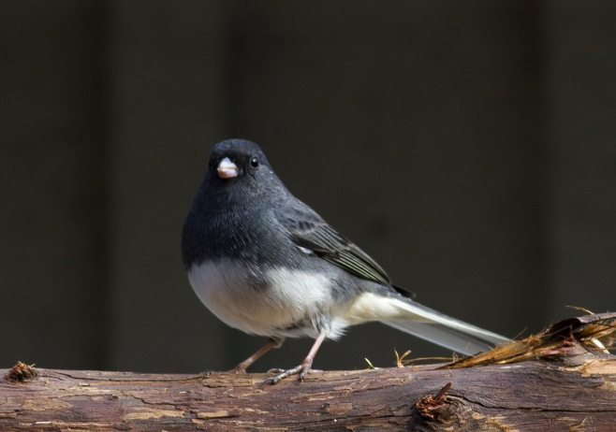
Dark Eyed Juncos
                A hooded gray and white sparrow with white outer tail feathers.
                Song is loose trill and its call is a smack sound.
                Juncos migrate from higher to lower elevations in the fall. Sometimes called snow birds.

Slide 22
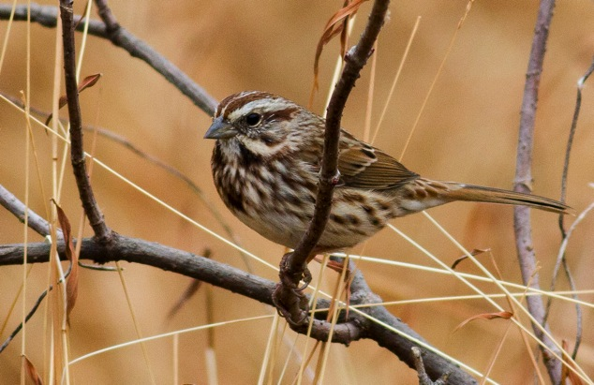
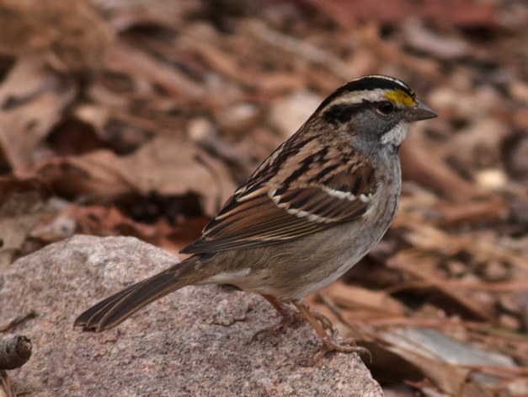
Song & White-Throated Sparrows
                The Song Sparrow is a medium sized bird with a long rounded tail with heavy breast streaks. White-Throated Sparrows have a white throat and a yellow lore.
                Song Sparrows sing a sweet sweet sweet with a musical trill. White-Throated Sparrows sounds like Poor Sam Peabody, Peabody

Slide 23
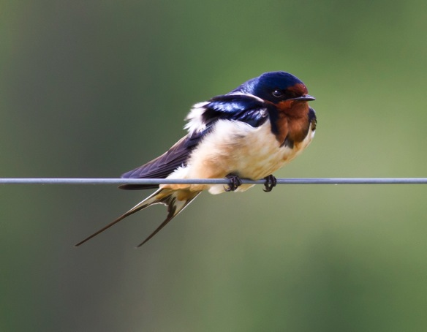
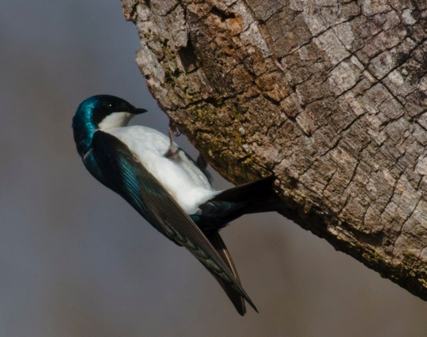
Barn and Tree Swallows
                Barn Swallows have deeply forked tail with white spots. Male tree swallows are steely blue tinged with green.
                Barn Swallows nest in mud cup nests in barns and under bridges. Tree Swallows nest in tree hollows and nest boxes.
                Swallows feed on insects on the wing.

Slide 24
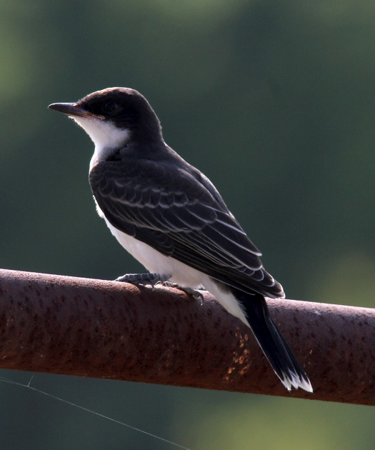
Eastern Kingbird
                Eastern Kingbirds have a white band across the tip of the tail.
                Their song is a series of buzzy notes like dzee-dzee-dzee.
                This flycatcher eats insects and seems to prefer bees

Slide 25
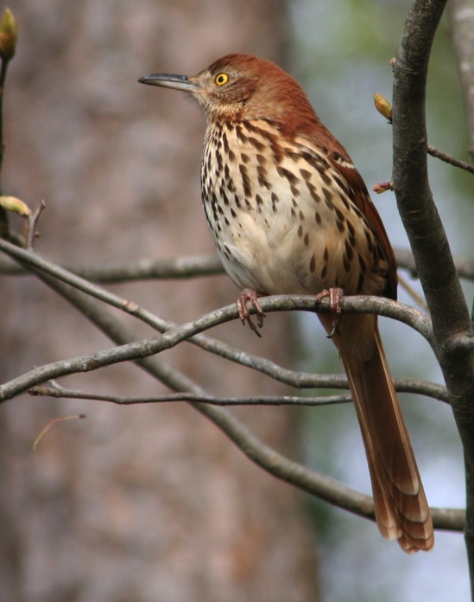
Brown Thrasher
                Brown Thrashers are larger than a robin with bright red-brown above with heavy streaking below.
                Thrashers sing a series of paired phrases that imitate other birds. Its call is a harsh chack!
                Often seen flying between bushes.

Slide 26
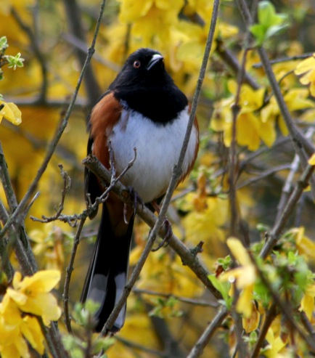
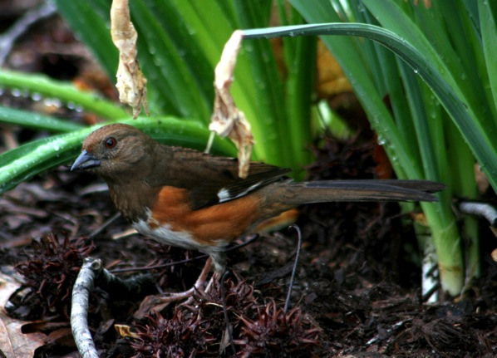
Eastern Towhee
                The male is a black backed rufous sided bird with a long tail edged in white. Female is a browner, duller version.
                Bird seems to say Drink-Your Tea. Call is a gu-ee?
                Bird is often seen scratching through the leaf litter.

Slide 27
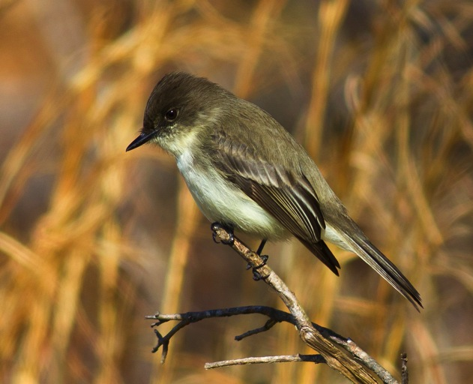
Eastern Phoebe
                A grayish sparrow sized dark headed bird without an eye ring or strong wing bars.
                Sings its name phoe-be or fi-bree over and over.
                Has a habit of tail bobbing and often nests near people.

Slide 28
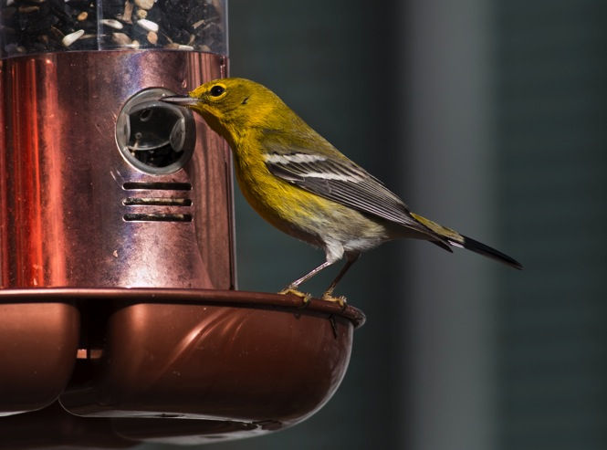
Pine Warbler
                The male is yellow throated with a olive green back and white wing bars. Female is less conspicuous.
                Song is a trill like the chipping sparrow but more musical.
                This warbler is a year round resident of the pine forest.

Slide 29
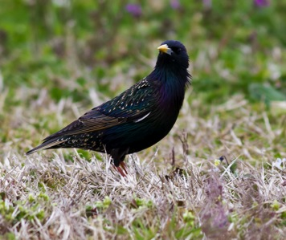
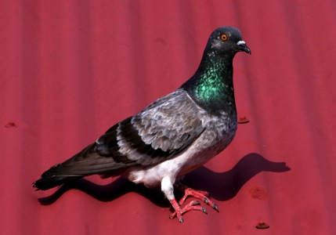
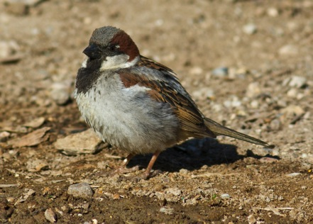
European Starling, Common Pigeon, House Sparrow
                All three birds are exotics (introduced) and are considered pests.
                Increased competition for food and nest sites with the native bird populations
                Alternative measures to help native bird are used when possible.

Slide 30
Thanks for Listening
Contact us at www.wakeaudubon.org

